Slide 1


Introduction to Software Business Product Management
Week 2 Day 3
Led by: Emily Crose
for
Oakland University

Slide 2
Day 2 Recap

Slide 3

Questions From Day 2?

Slide 4
Terms To Listen For
Discretionary Access Control (DAC)
A method of access control provisioned by an administrator
Mandatory Access Control (MAC)
Access control provisioned by data labeling
Authentication
Refers to the process of verifying a user’s identity.
Denial of Service
A forced outage of a service based on a misconfiguration or a concerted effort

Slide 5

Access Control

Slide 6

MAC, DAC, and RBAC

Slide 7

Mandatory Access Control

Slide 8
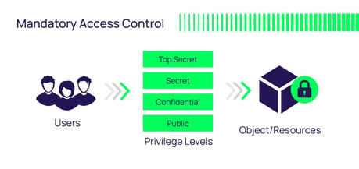
Mandatory Access Control (MAC)
Notes:
The important piece for MAC is that access to a resource is based on the sensitivity label of the information.

Slide 9


Discretionary Access Control (DAC)

Slide 10
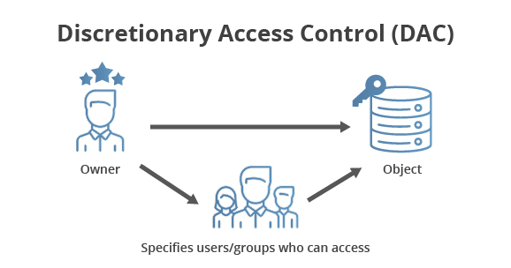
DAC

Slide 11
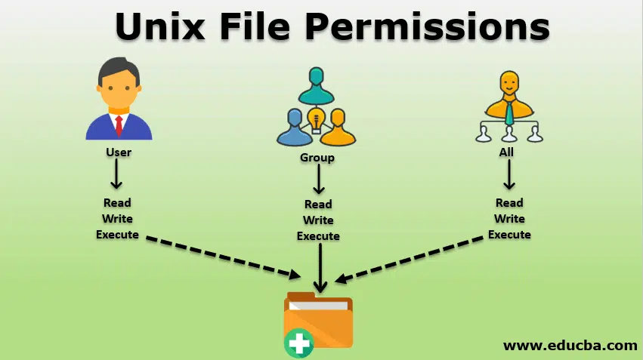
DAC In Action

Slide 12
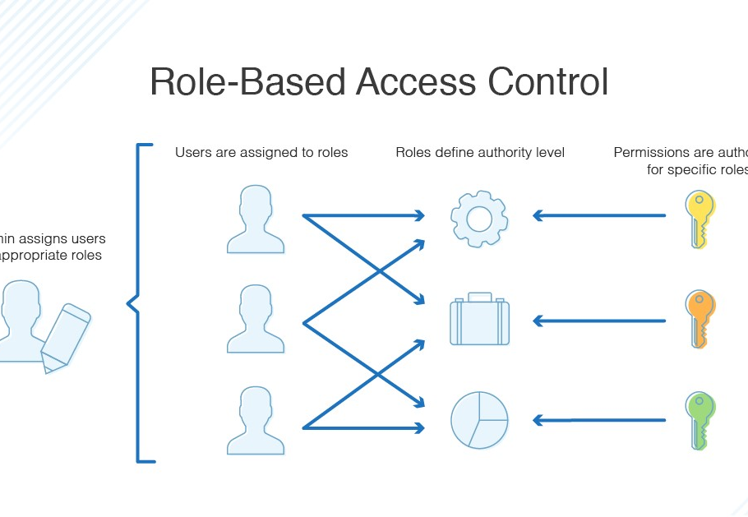
Role Based Access Control (RBAC)

Slide 13
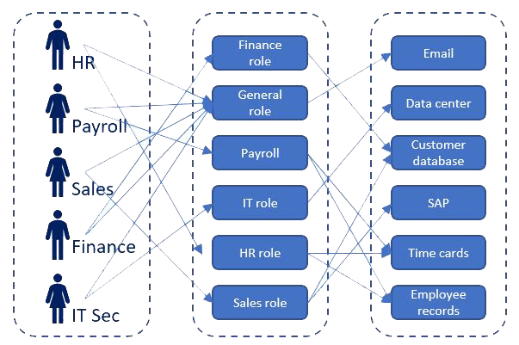
RBAC In Action

Slide 14
Pentesting Methodology

Slide 15
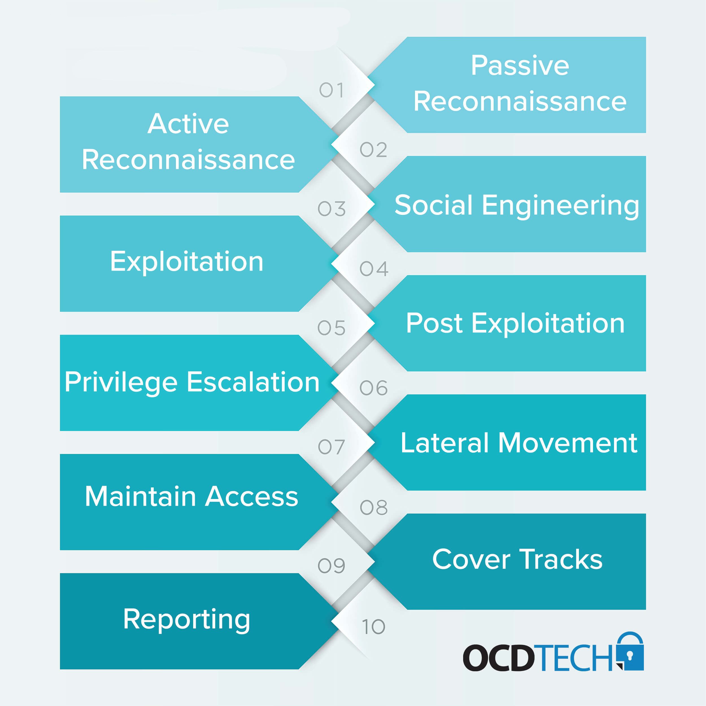

Slide 16
Standards

Slide 17


OWASP

Slide 18
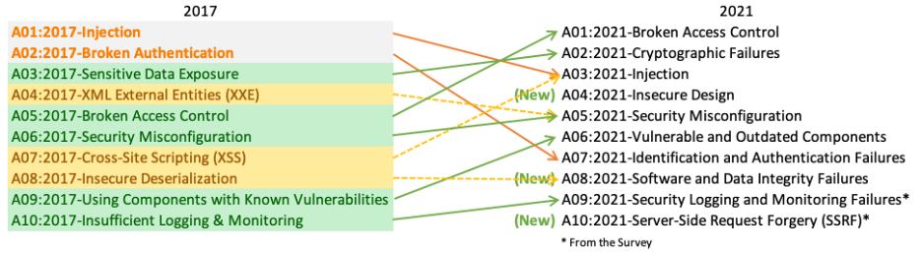
OWASP Top 10

Slide 19

Mobile Application Security Verification Standard (MASVS)
https://github.com/OWASP/owasp-masvs/

Slide 20


Slide 21
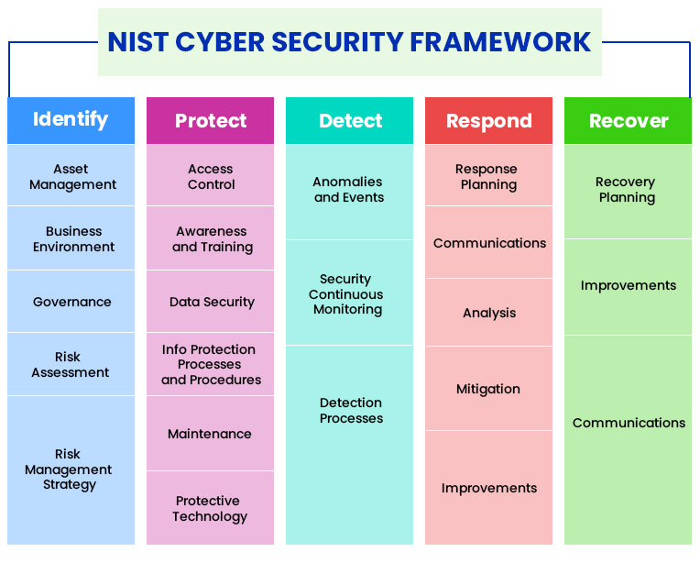
NIST Cybersecurity Framework

Slide 22

10-minute break

Slide 23

Question or clarifications?

Slide 24

Review Day 3

Slide 25

Preview Week 3

